Slide 1
Vectors
Dr. Jacob Moore
Associate Professor of Mechanical Engineering
Penn State Mont Alto

Slide 2

Vectors
A vector is a quantity that has both a magnitude and a direction.
Usually represented as an arrow.
When working with vectors, it is important to take into consideration both the magnitude and the direction in our equations.
We can’t just treat them as scalar quantities.
Examples of vector quantities include:
Forces
Velocities
Accelerations
$$F = 600 N$$

Slide 3
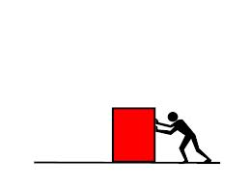

Vector Representation
Vectors are generally represented in one of two forms:
As a total magnitude and a direction
As magnitude in each coordinate axis
y
F = 70 lbs
15º
x
y
$\vec{F}$ = [-67.6, 18.1] lbs
x

Slide 4


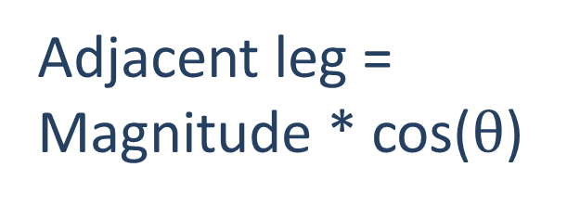
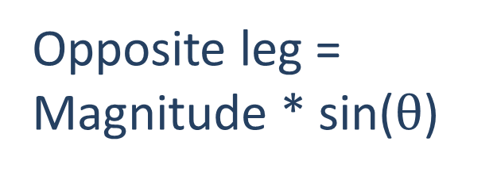

Converting Between Forms
When converting between forms, we use right triangle representations and basic trigonometric properties.
Opposite leg = Magnitude * sin($θ$)
$$F = 600 N$$
y
$$Fy = 600 ∗sin(35o)$$
35º
Adjacent leg = Magnitude * cos($θ$)
x
$$Fx = 600 ∗cos(35o)$$

Slide 5


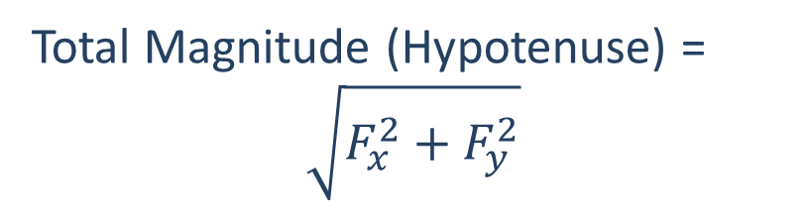


Converting Between Forms
When converting between forms, we use right triangle representations and basic trigonometric properties.
Total Magnitude (Hypotenuse) =
$$\sqrt{F_{x}^{2}+F_{y}^{2}}$$
$$F=\sqrt{{300}^{2}+{200}^{2}}$$
y
$$Fy=200 N$$
$$θ=\tan^{−1}\left(\frac{200}{300}\right)$$
Angle = tan⁻¹(opposite/adjacent)
x
$$Fx=300 N$$

Slide 6








Be Careful
Changing how you measure the angle will change the equations you use.
$$Fx =F sin(θ)$$
$$Fy =F cos(θ)$$
y
$$F$$
y
$$θ$$
$$F$$
$$Fy =F sin(θ)$$
$$θ$$
x
x
$$Fx =F cos(θ)$$

Slide 7
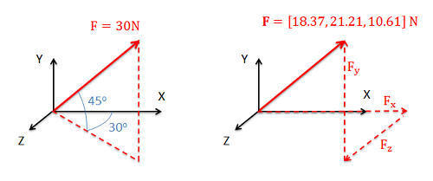
Vectors in 3D
In three dimensions, we need either...
two angles and a magnitude
or, three components

Slide 8
Converting Between Forms
To convert between forms in this case, we will use two right triangles, where the leg of one triangle will be the hypotenuse of the other right triangle.
Again you will use trig relationships to convert back and forth.

Slide 9












Converting Between Forms
y
$$F$$
$$F_{y}$$
$$ϕ$$
Triangle 1
$$F_{x}$$
x
$$θ$$
Triangle 2
$$F_{xz}$$
$$F_{z}$$
z
Triangle 1
$$F_{y}=F sin(φ)$$
Triangle 2
$$F$$
$$F_{x}=F_{xz} cos\left(θ\right)=\left(F cos\left(φ\right)\right)cos\left(θ\right)$$
$$F_{xz}=F cos(φ)$$
$$F_{z}=F_{xz} sin\left(θ\right)=\left(F cos\left(φ\right)\right)sin\left(θ\right)$$

Slide 10
3D Vectors Shortcut
Sometimes we will have a force or velocity along some predetermined direction as determined by a bodies geometry.
To find the components of this vector, we could determine the angles of the cable, but there is a faster method using ratios.
T = 3 kN
y
6 m
x
2 m
z
3 m

Slide 11
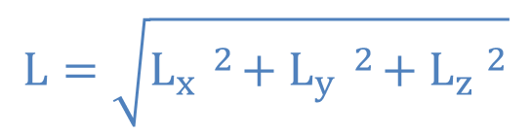
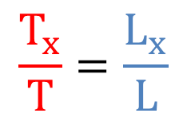




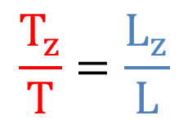

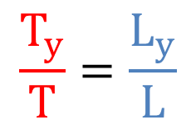
3D Vectors Shortcut
y
The ratio of each component of the tension force over the total tension force will be equal to the corresponding length in the given direction over the total length.
$$L_{z}$$
$$L$$
$$L_{y}$$
$$T$$
x
$$L_{x}$$
$$L=\sqrt{L_{x} ^{2}+L_{y} ^{2}+L_{z} ^{2}}$$
z
$$\frac{T_{x}}{T}=\frac{L_{x}}{L}$$
$$\frac{T_{y}}{T}=\frac{L_{y}}{L}$$
$$\frac{T_{z}}{T}=\frac{L_{z}}{L}$$

Slide 12
Thanks for Watching
See other engineering mechanics videos and access the full tool at…

Slide 13
Vector Worked Example
Determine the x and y components of the force vector shown below.
F = 300 N
40º

Slide 14
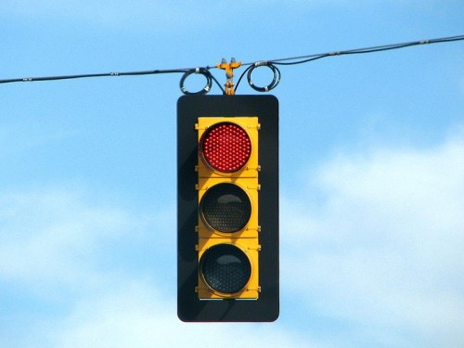
Vector Worked Example
Determine the x and y components of the vector shown below.
75º
T₁ = 60 lbs

Slide 15

Vector Worked Example
The velocity vector of the hockey puck shown below is given in component form. Determine the magnitude and direction of the velocity with respect to the axes given.
y
x
$\vec{v}$ = [5, -2.5] m/s

Slide 16



Vector Worked Example
Determine the x, y, and z components of the force vector shown to the right.
y
x
$$20°$$
$$30°$$
z
4$5 N$

Slide 17
Vector Worked Example
A cable as shown to the right is used to tether the top of a pole to a point on the ground. The cable has a tension force of 3 kN that acts along the direction of the cable as shown. What are the x, y, and z components of the tension force acting on the top of the pole?
T = 3 kN
6 m
y
x
2 m
3 m
z

